Slide 1
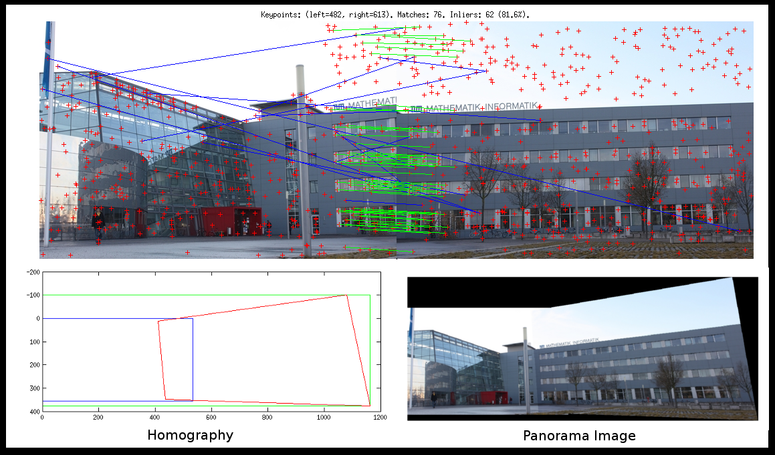
Features

Slide 2
References
http://szeliski.org/Book/
http://www.cs.cornell.edu/courses/cs5670/2019sp/lectures/lectures.html
http://www.cs.cmu.edu/~16385/
https://medium.com/software-incubator/introduction-to-orb-oriented-fast-and-rotated-brief-4220e8ec40cf
https://opencv-python-tutroals.readthedocs.io/en/latest/py_tutorials/py_feature2d/py_table_of_contents_feature2d/py_table_of_contents_feature2d.html
https://towardsdatascience.com/sift-scale-invariant-feature-transform-c7233dc60f37

Slide 3
Feature detection
Talk about harris corner detector?
Feature descriptor and matching
Sift
Talk about orb
Panorama

Slide 4
What is a feature?
There is no universal or exact definition of what constitutes a feature, and the exact definition often depends on the problem or the type of application. Given that, a feature is defined as an "interesting" part of an image.
[from: wikipedia]

Slide 5
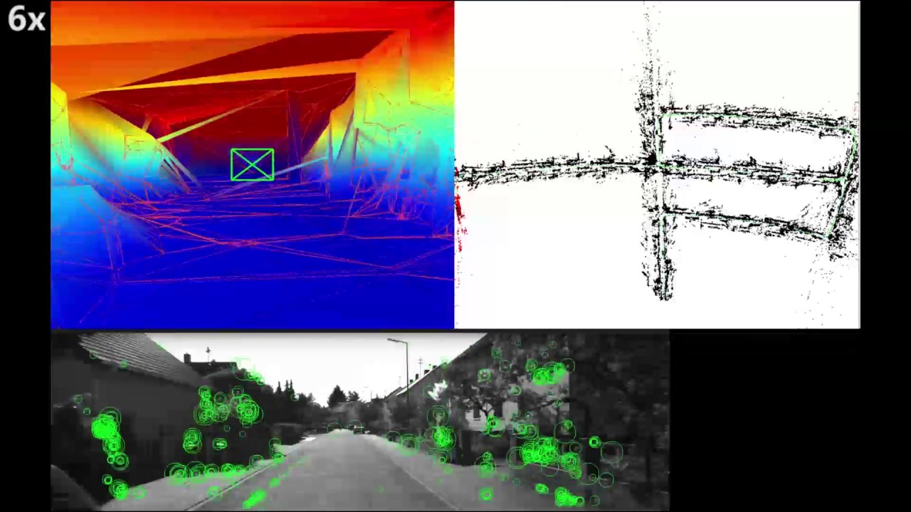
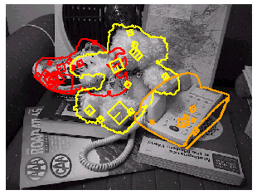
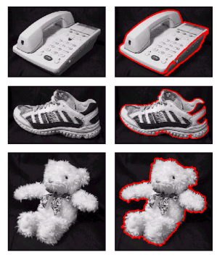
What can we do with features?
Robot navigation
Object recognition
Panorama stitching

Slide 6

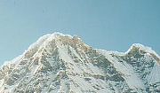
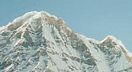
Local features: main components
1. Detection: Identify the interest points (also called keypoints).
2. Description: Extract vector feature descriptor surrounding each interest point.
3. Matching: Determine correspondence between descriptors in two views.

Slide 7
detection

Slide 8
Global detection
Template matching

Slide 9
Advantages of local keypoints
Locality:
features are local, so robust to occlusion and clutter
Quantity:
hundreds or thousands in a single image
Distinctiveness:
can differentiate a large database of objects
Efficiency
real-time performance achievable

Slide 10
Local measures of uniqueness
Suppose we only consider a small window of pixels.
How does the window change when you shift it?
Credit: S. Seitz, D. Frolova, D. Simakov
Notes:
High level idea is that corners are good. You want to find windows that contain strong gradients AND gradients oriented in more than one direction

Slide 11
Local measures of uniqueness
Suppose we only consider a small window of pixels-
How does the window change when you shift it?
“flat” region: no change in all directions
“edge”:
no change along the edge direction
“corner”: significant change in all directions

Slide 12
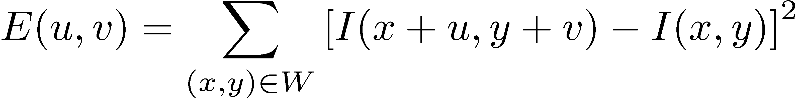
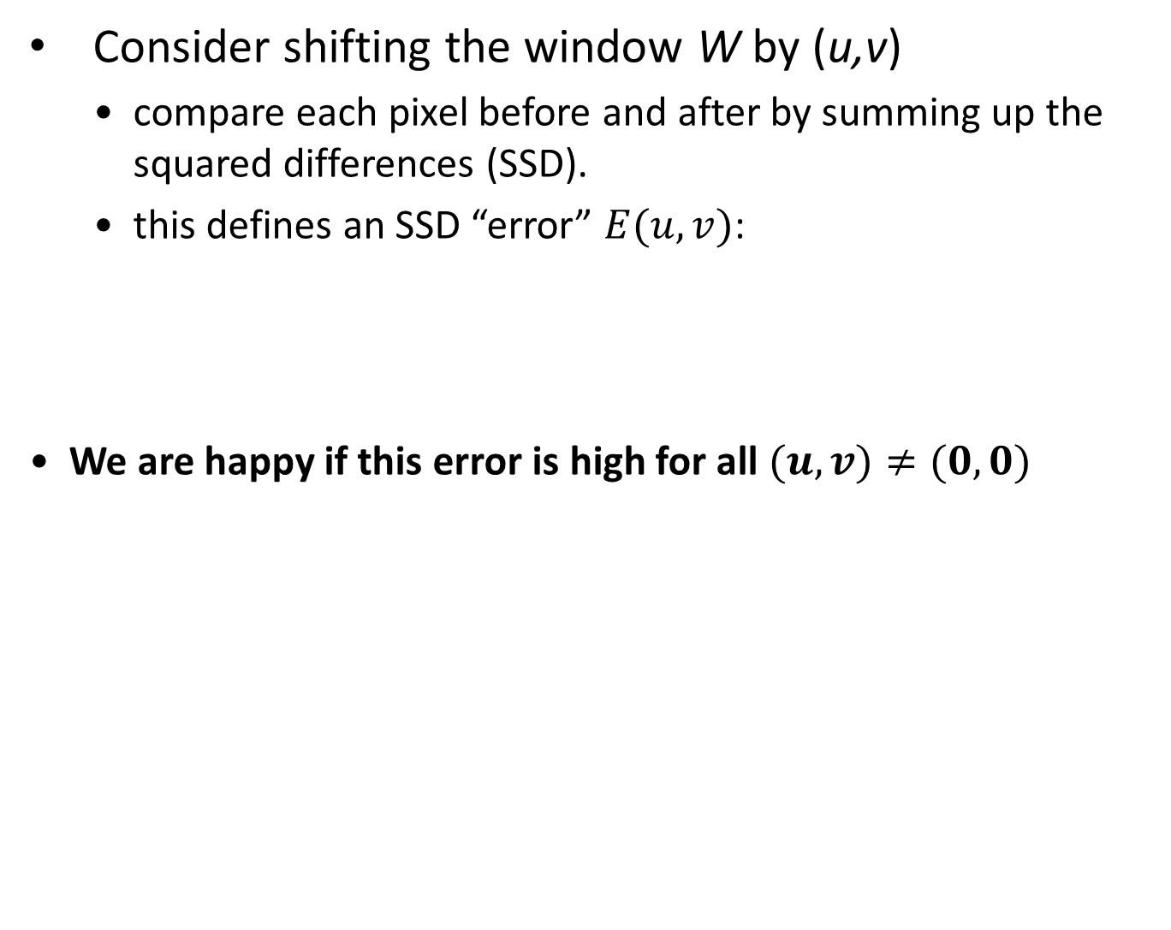
Harris corner detection
Consider shifting the window W by (u,v)
compare each pixel before and after by summing up the squared differences (SSD).
this defines an SSD “error” $E(u,v)$:
We are happy if this error is high for all $(u,v)≠(0,0)$
_{(u,v)}
W

Slide 13
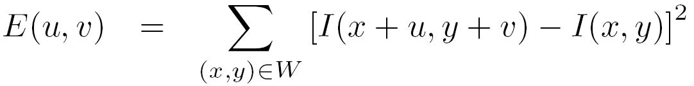
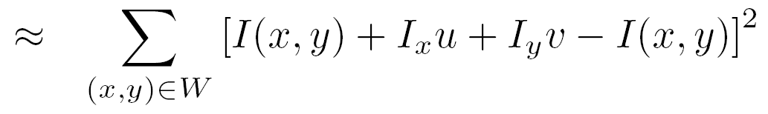
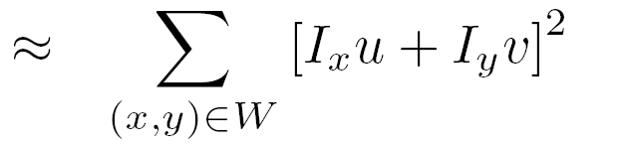
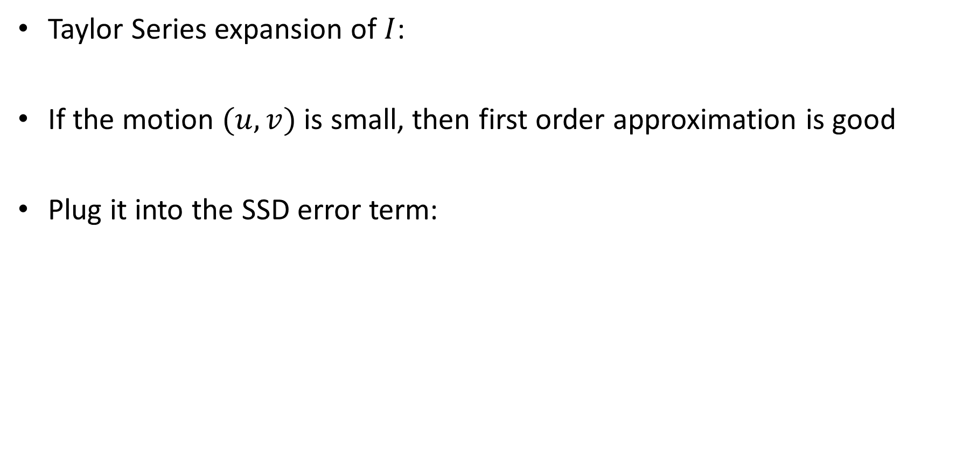
Harris corner detection
Taylor Series expansion of $I$:
If the motion $(u,v)$ is small, then first order approximation is good
Plug it into the SSD error term:

Slide 14
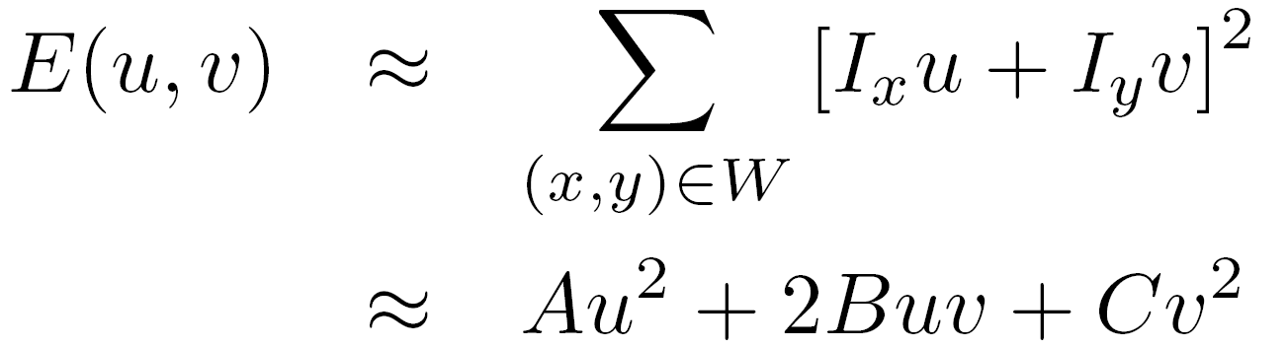
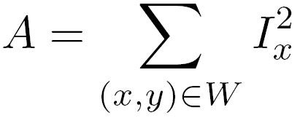
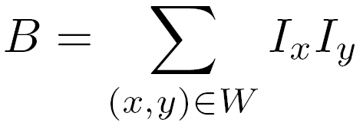
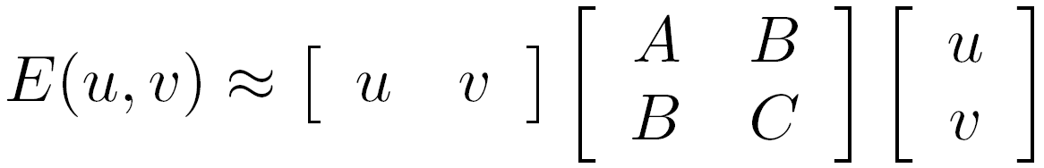
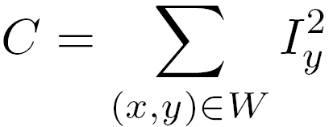

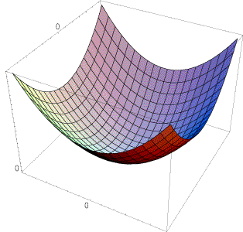
Harris corner detection
Also called second-moments matrix
E(u,v)
v
u

Slide 15
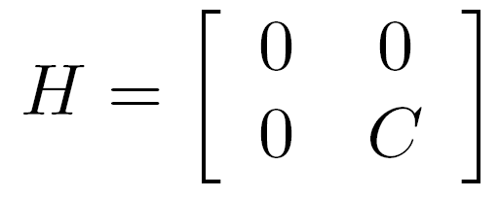
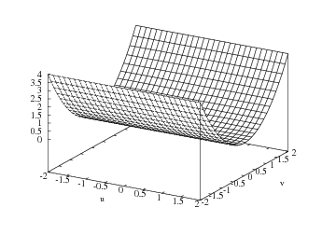
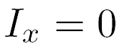
Harris corner detection
E(u,v)
Horizontal edge:
v
u

Slide 16
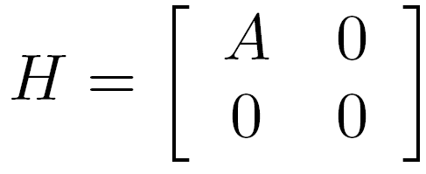
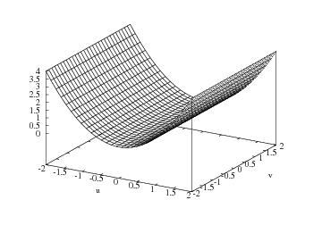
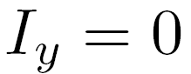
Harris corner detection
E(u,v)
Vertical edge:
v
u

Slide 17
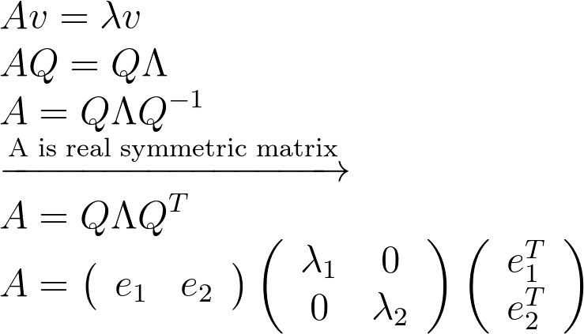
Harris corner detection: probabilistic interpretation
4. Compute the eigendecomposition
A real symmetric matrix has an eigendecomposition of:
Bonus: eigenvectors are orthonormal if A is real and symmetric.
Notes:
\\
Av = \lambda v
\\
AQ=Q\Lambda
\\
A=Q\Lambda Q^{-1}
\\
\xrightarrow{\text{A is real symmetric matrix}}
\\
A=Q\Lambda Q^{T}
\\
A=\left(\begin{array}{ll}{e_{1}} & {e_{2}}\end{array}\right)\left(\begin{array}{cc}{\lambda_{1}} & {0} \\ {0} & {\lambda_{2}}\end{array}\right)\left(\begin{array}{c}{e_{1}^{T}} \\ {e_{2}^{T}}\end{array}\right)

Slide 18
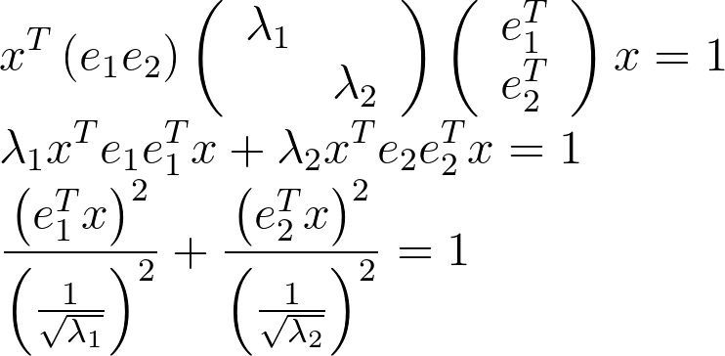
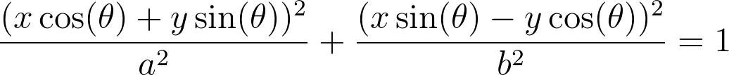
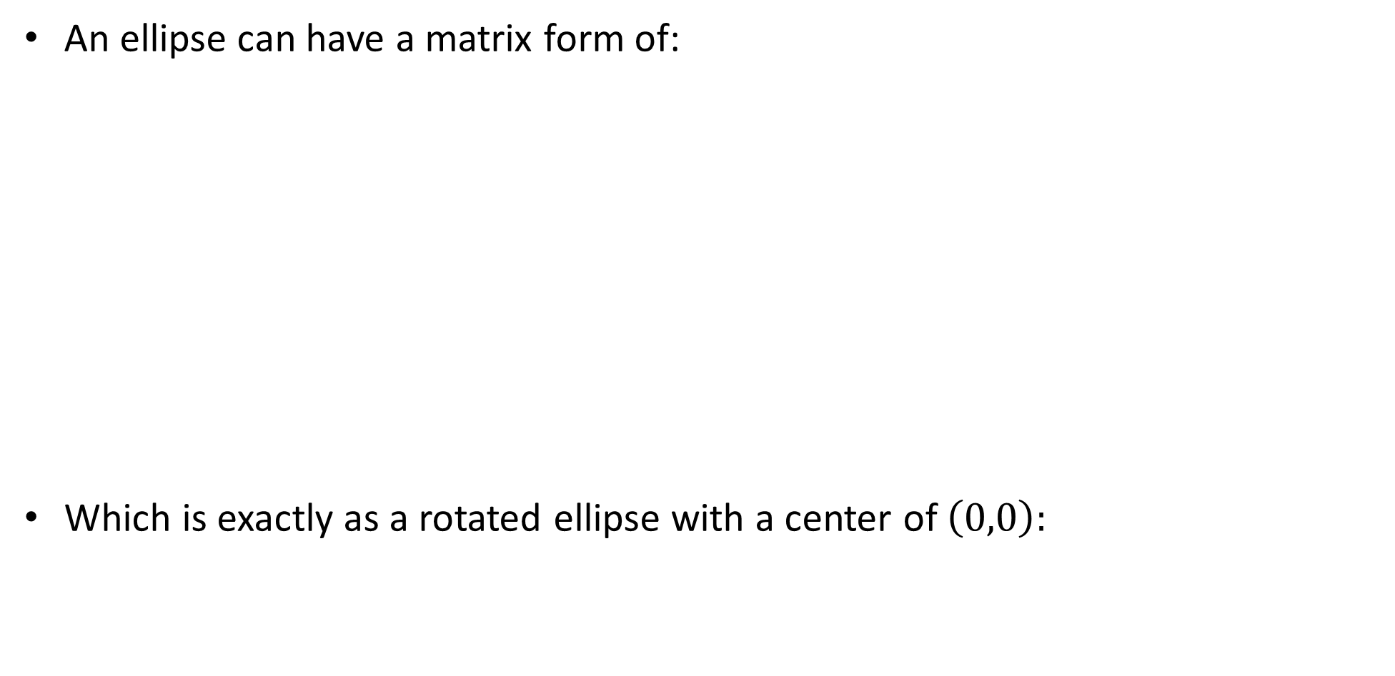
Harris corner detection
An ellipse can have a matrix form of:
Which is exactly as a rotated ellipse with a center of $\left(0,0\right):$
Notes:
\\
x^{T}\left(e_{1} e_{2}\right)\left(\begin{array}{cc}{\lambda_{1}} \\ {} & {\lambda_{2}}\end{array}\right)\left(\begin{array}{c}{e_{1}^{T}} \\ {e_{2}^{T}}\end{array}\right) x=1
\\
\lambda_{1} x^{T} e_{1} e_{1}^{T} x+\lambda_{2} x^{T} e_{2} e_{2}^{T} x =1
\\
\frac{\left(e_{1}^{T} x\right)^{2}}{\left(\frac{1}{\sqrt{\lambda_{1}}}\right)^{2}}+\frac{\left(e_{2}^{T} x\right)^{2}}{\left(\frac{1}{\sqrt{\lambda_{2}}}\right)^{2}}=1
=============================================
\frac{(x \cos (\theta)+y \sin (\theta))^{2}}{a^2}+\frac{(x \sin (\theta)-y \cos (\theta))^2}{b^{2}}=1

Slide 19
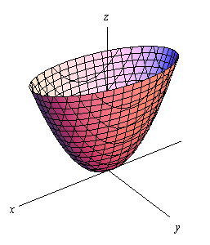
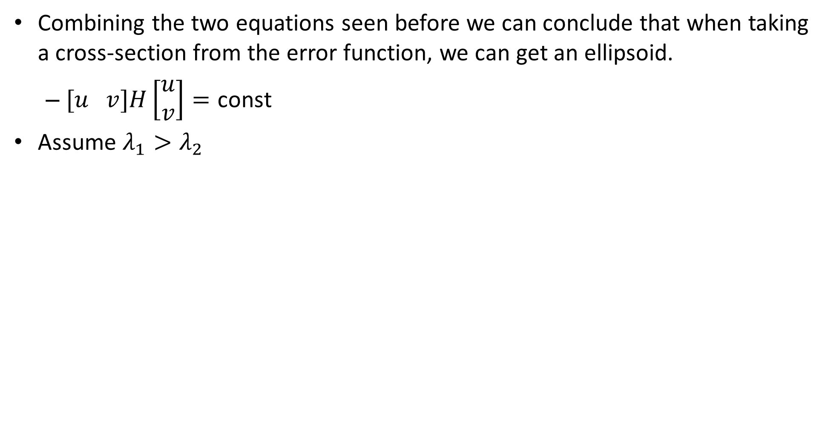

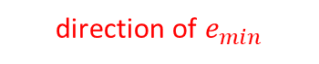
Harris corner detection
Combining the two equations seen before we can conclude that when taking a cross-section from the error function, we can get an ellipsoid.
$[u v]H\left[\begin{matrix}u \\ v\end{matrix}\right]=\text{const}$
Assume $λ_{1}>λ_{2}$
direction of $e_{max}$
direction of $e_{min}$
(λ_{max})^{-1/2}
(λ_{min})^{-1/2}

Slide 20
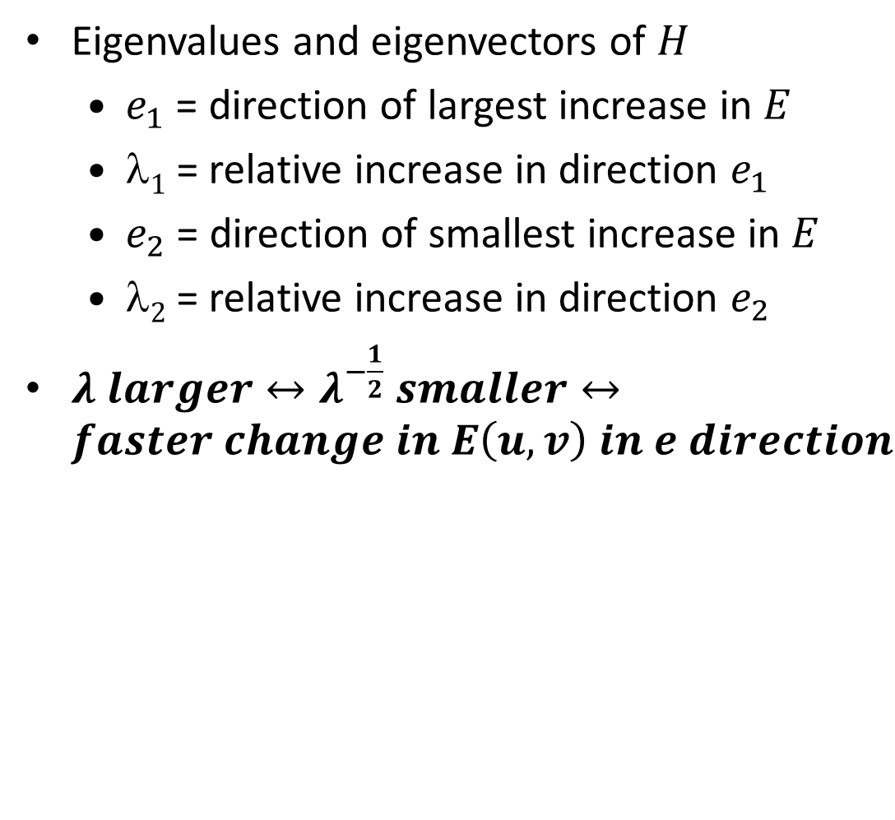
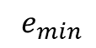
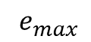
Harris corner detection
Eigenvalues and eigenvectors of $H$
$e_{1}$ = direction of largest increase in $E$
$1$= relative increase in direction $e_{1}$
$e_{2}$ = direction of smallest increase in $E$
$2⁡$= relative increase in direction $e_{2}$
$λ larger↔λ^{−\frac{1}{2}} smaller↔faster change in E\left(u,v\right) in e direction$
$e_{min}$
$e_{max}$
direction of $e_{max}$
direction of $e_{min}$
(λ_{max})^{-1/2}
(λ_{min})^{-1/2}

Slide 21
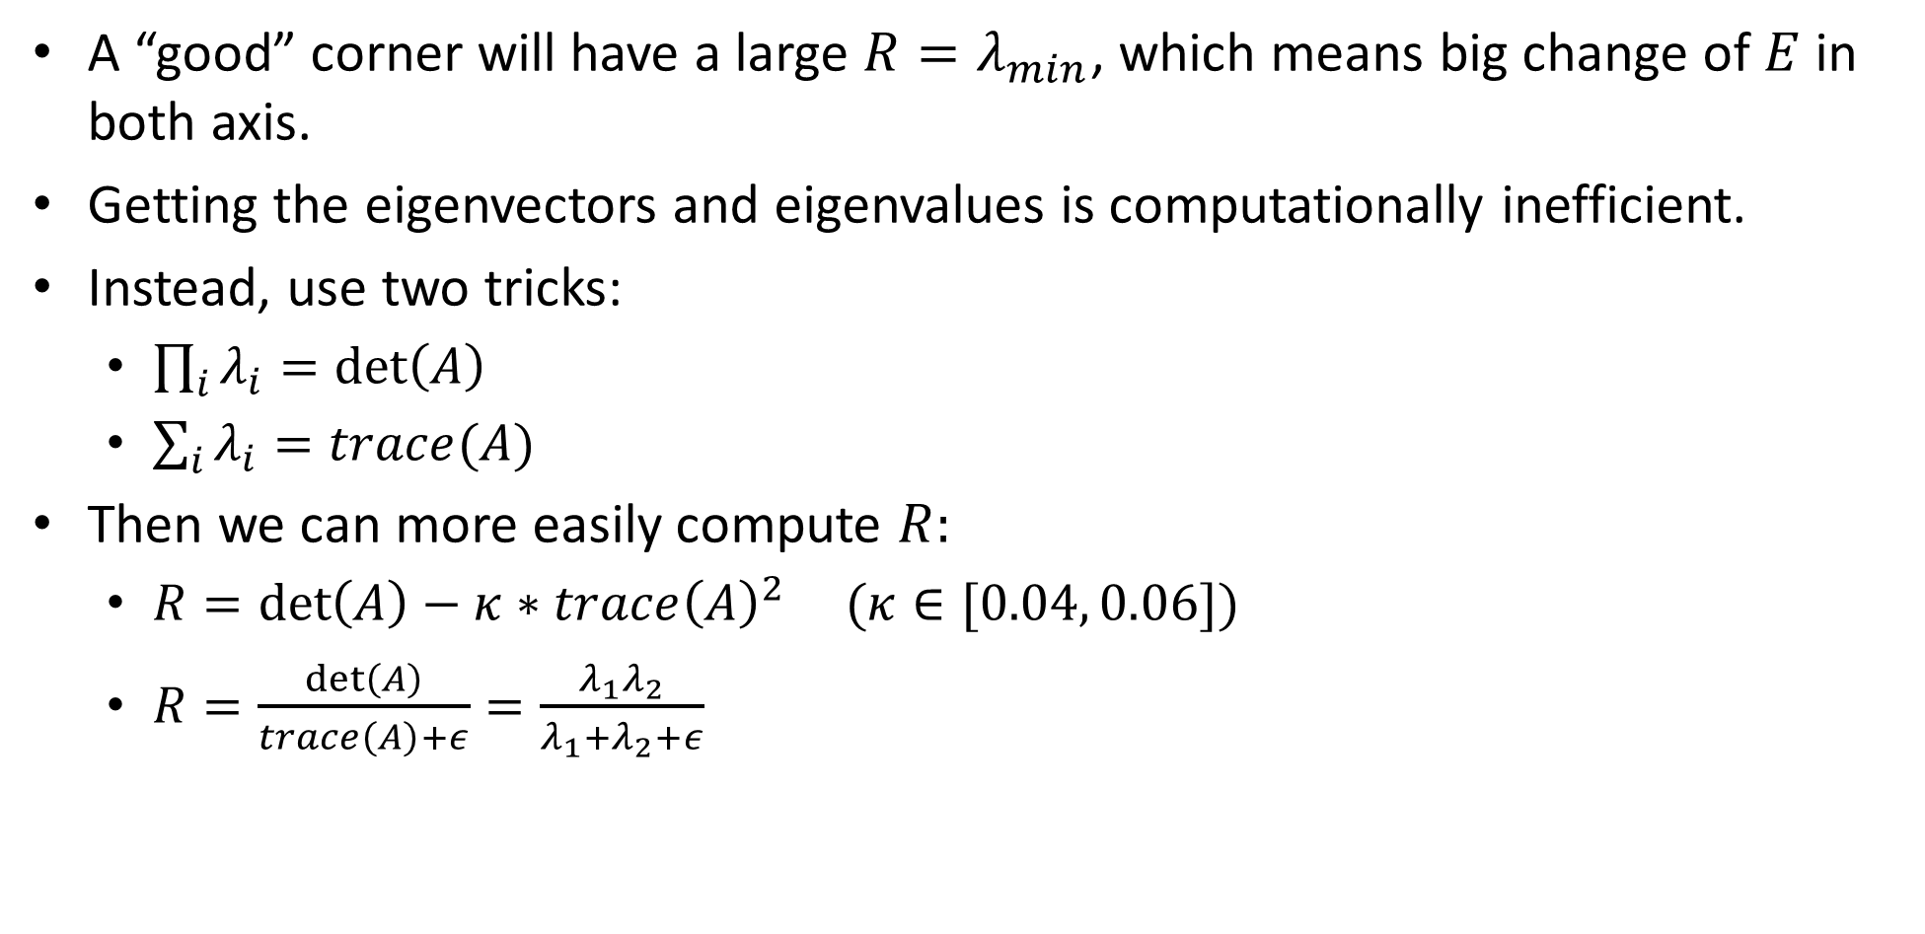
Interpreting the eigenvalues
A “good” corner will have a large $R=λ_{min}$, which means big change of $E$in both axis.
Getting the eigenvectors and eigenvalues is computationally inefficient.
Instead, use two tricks:
$\prod_{i}{λ_{i}}=\det\left(A\right)$
$\sum_{i}{λ_{i}=trace(A)}$
Then we can more easily compute $R:$
$R=\det\left(A\right)−κ∗trace{\left(A\right)}^{2}$ $(κ∈[0.04, 0.06])$
$R=\frac{\det\left(A\right)}{trace\left(A\right)+ε}=\frac{λ_{1}λ_{2}}{λ_{1}+λ_{2}+ε}$

Slide 22
Interpreting the eigenvalues
λ₂
“Edge” λ₂ >> λ₁
“Corner” λ₁ and λ₂ are large, λ₁ ~ λ₂; E increases in all directions
λ₁ and λ₂ are small; E is almost constant in all directions
“Flat” region
“Edge” λ₁ >> λ₂
λ₁

Slide 23

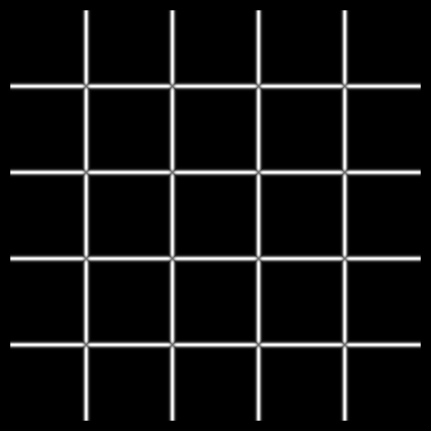



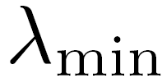
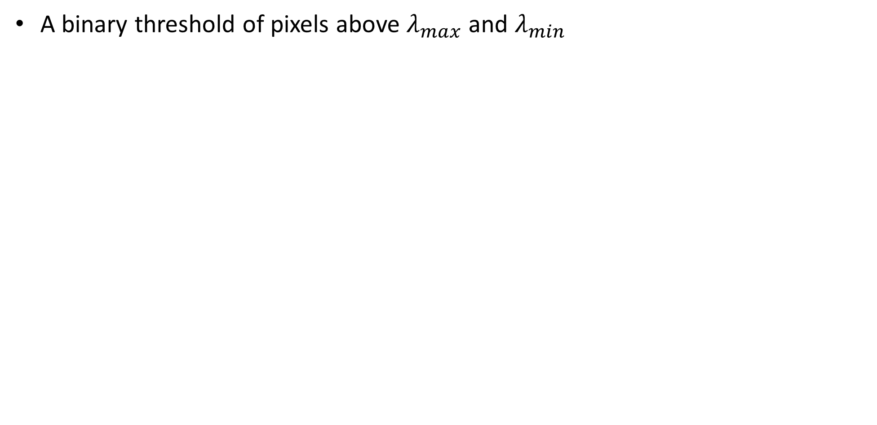
Interpreting the eigenvalues
A binary threshold of pixels above $λ_{max}$ and $λ_{min}$

Slide 24
Harris corner detection
Compute gradients of patch around each pixel.
Subtract the mean from each patch gradient.
Compute the second-moment matrix.
Compute eigendecomposition of covariance matrix.
Use eigenvalues to find corners.
This is PCA (principal component analysis). Out of scope but really interesting!

Slide 25

Harris detector example

Slide 26

f value (red high, blue low)

Slide 27

Threshold (f > value)

Slide 28
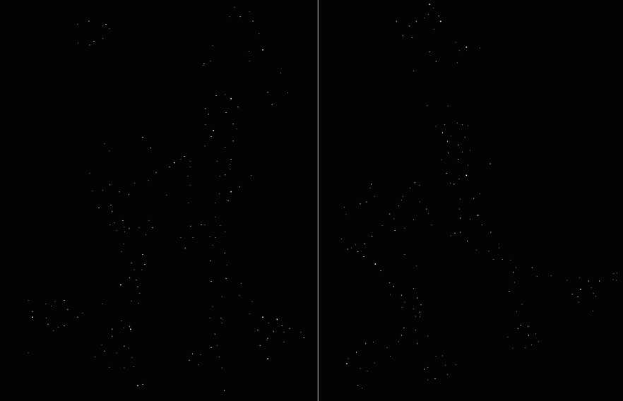
Find local maxima of f

Slide 29

Harris features (in red)

Slide 30
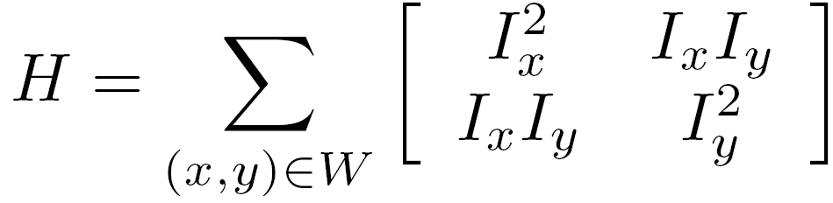
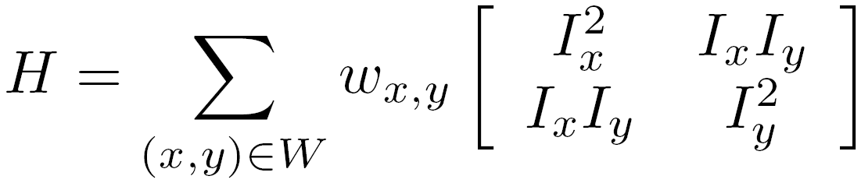
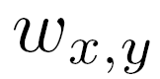
Weighting the derivatives
In practice, using a simple window W doesn’t work too well
Instead, we’ll weight each derivative value based on its distance from the center pixel

Slide 31
Harris corner response is invariant to rotation
Ellipse rotates but its shape
(eigenvalues) remains the same
Corner response R is invariant to image rotation

Slide 32
Harris corner response is invariant to intensity changes
Partial invariance to affine intensity change
Only derivatives are used => invariance to intensity shift I → I + b
Intensity scale: I → a I
R
R
threshold
x (image coordinate)
x (image coordinate)

Slide 33


The Harris corner detector is not invariant to scale
edge!
corner!

Slide 34
Multi-scale blob detection

Slide 36
Intuitively…
Find local maxima in both position and scale
f
f
Image 1
Image 2
s₁
region size
s₂
region size

Slide 37
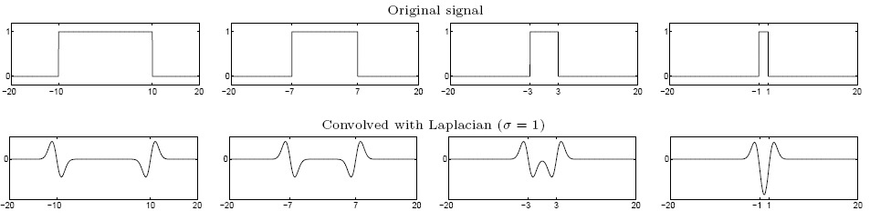
Formally…
Laplacian filter
Highest response when the signal has the same characteristic scale as the filter

Slide 38
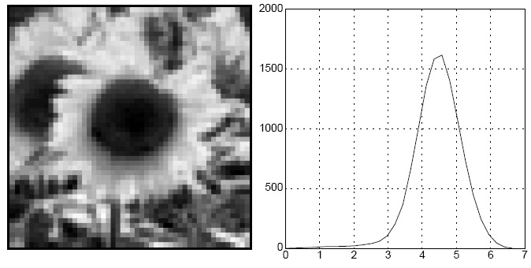


characteristic scale - the scale that produces peak filter response
characteristic scale
we need to search over characteristic scales

Slide 39
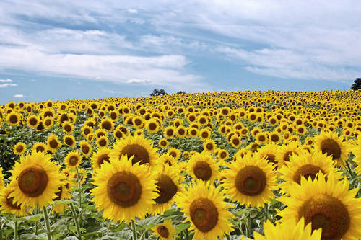
What happened when you applied different Laplacian filters?
Full size
3/4 size

Slide 40
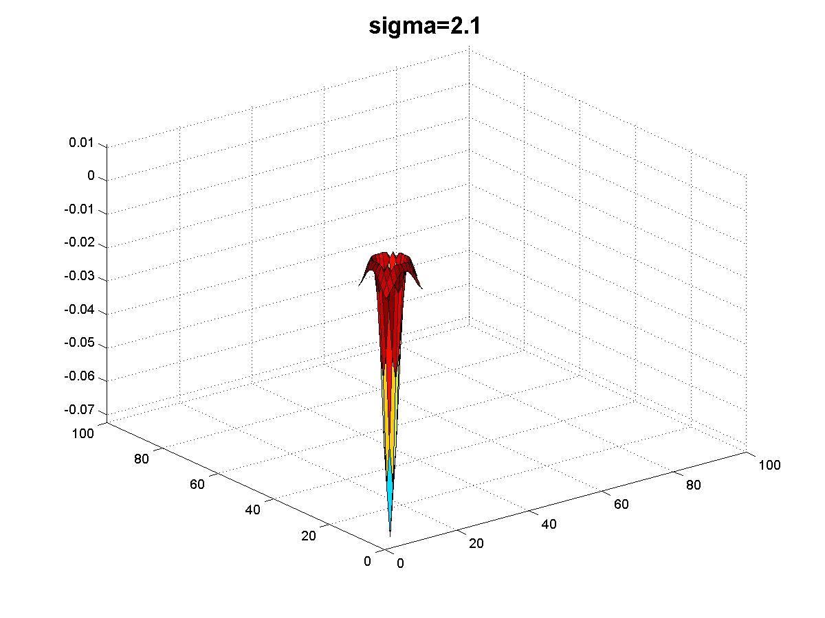
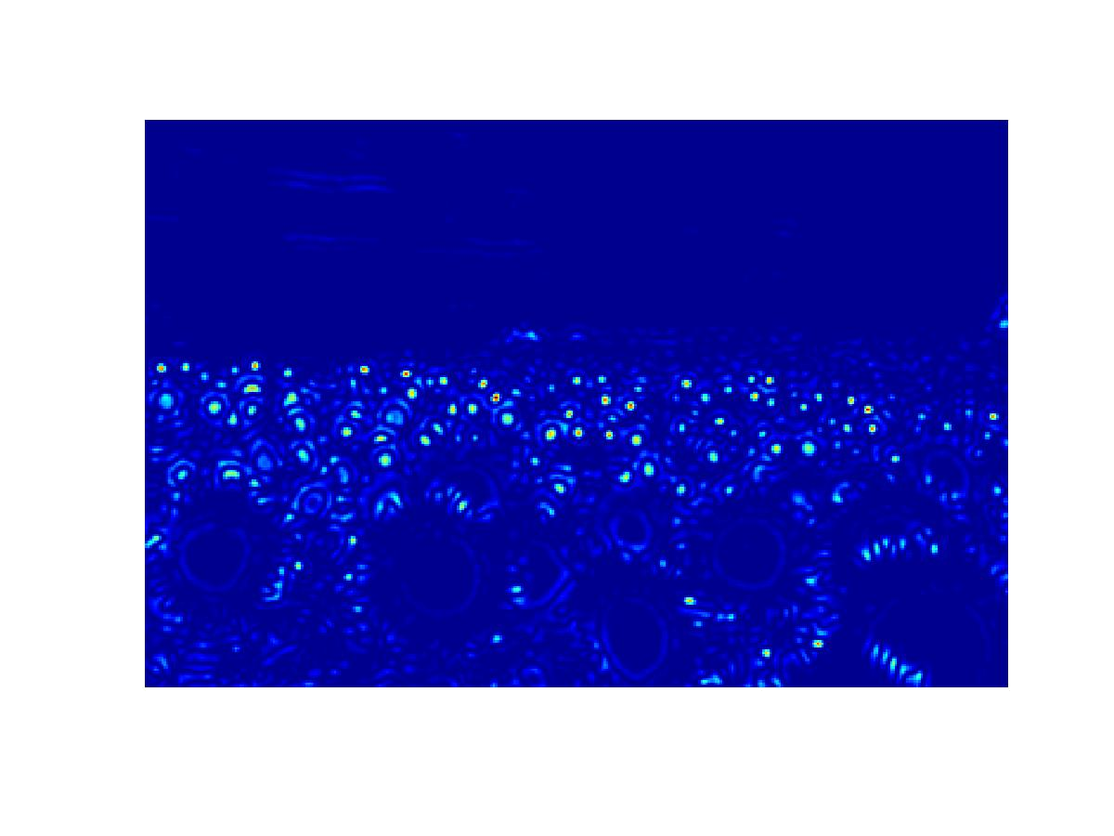
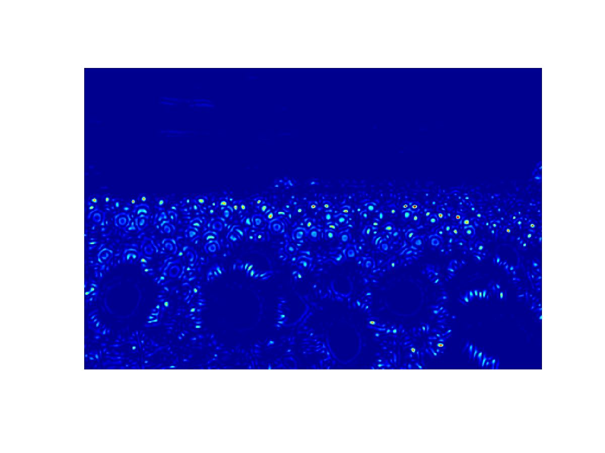

Slide 41
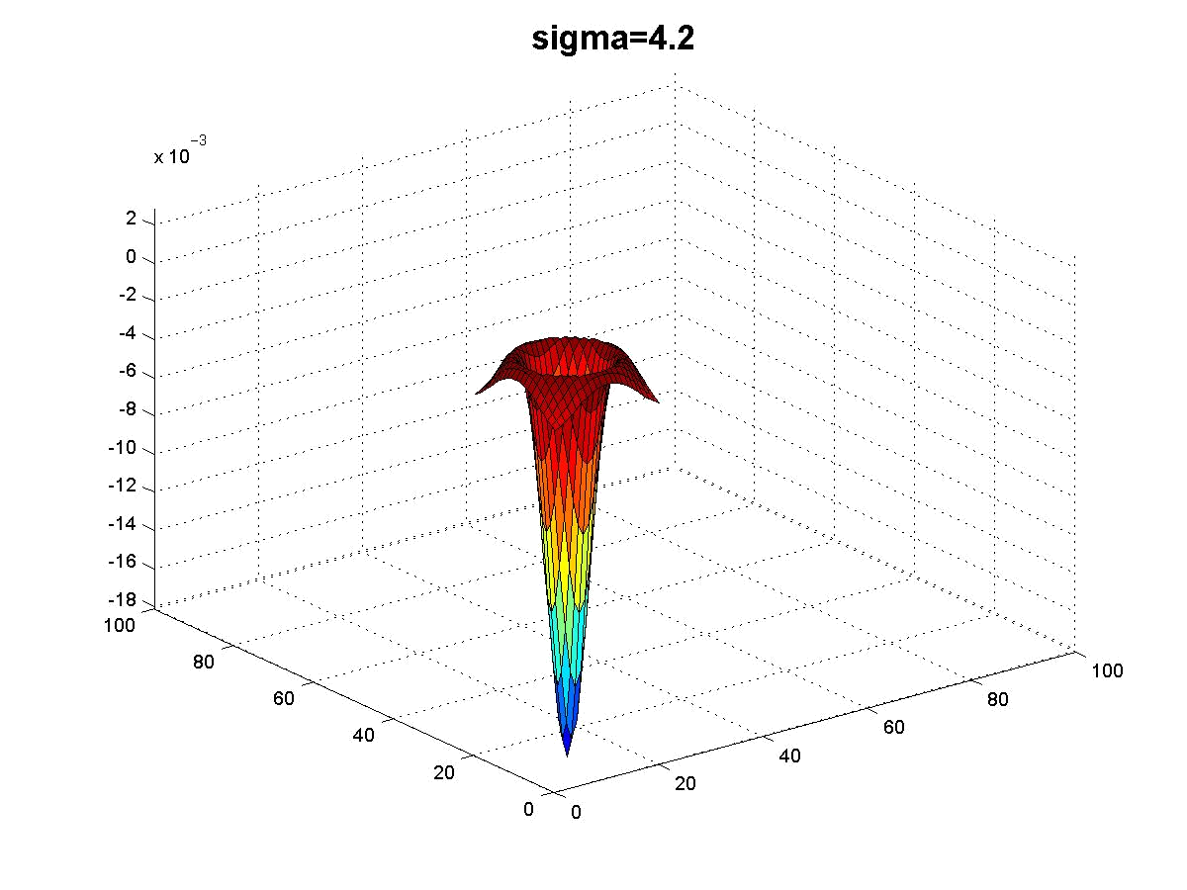
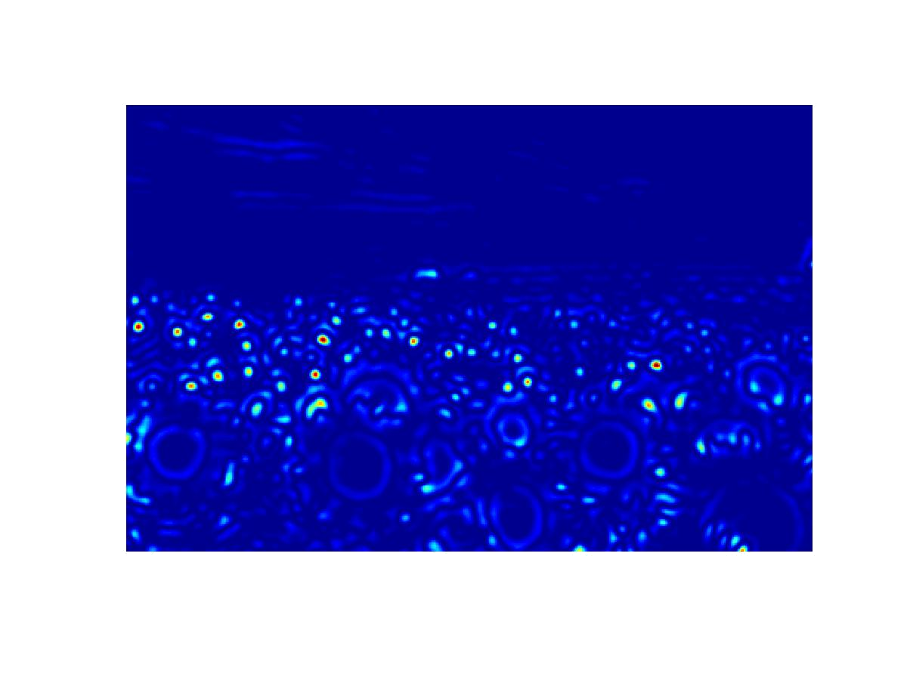


Slide 42



peak!

Slide 43



peak!

Slide 44




Slide 45




Slide 46
What happened when you applied different Laplacian filters?
Full size
3/4 size

Slide 47












optimal scale
2.1
4.2
6.0
9.8
15.5
17.0
Full size image
2.1
4.2
6.0
9.8
15.5
17.0
3/4 size image

Slide 48
optimal scale
2.1
4.2
6.0
9.8
15.5
17.0
maximum response
Full size image
2.1
4.2
6.0
9.8
15.5
17.0
maximum response
3/4 size image

Slide 49
4.2
cross-scale maximum
local maximum
6.0
9.8

Slide 50
How would you implement scale selection?

Slide 51

implementation
For each level of the Gaussian pyramid
compute feature response (e.g. Harris, Laplacian)
For each level of the Gaussian pyramid
if local maximum and cross-scale
save scale and location of feature

Slide 52


Slide 53


Slide 54


Gaussian
Laplacian

Slide 55

Invariant local features
Find features that are invariant to transformations
geometric invariance: translation, rotation, scale
photometric invariance: brightness, exposure, …
Feature Descriptors

Slide 56


Why extract features?
Motivation: panorama stitching
We have two images – how do we combine them?

Slide 57

Why extract features?
Motivation: panorama stitching
We have two images – how do we combine them?
Step 1: extract features
Step 2: match features

Slide 58

Why extract features?
Motivation: panorama stitching
We have two images – how do we combine them?
Step 1: extract features
Step 2: match features
Step 3: align images

Slide 59


Harris corner detection: probabilistic interpretation
1. Compute image gradients over a small region
array of x gradients
array of y gradients

Slide 60
Harris corner detection: probabilistic interpretation
1. Compute image gradients over a small region
What does the distribution tell you about the region?

Slide 61
Harris corner detection: probabilistic interpretation
1. Compute image gradients over a small region
distribution reveals edge orientation and magnitude

Slide 62


Harris corner detection: probabilistic interpretation
2. Subtract the mean from each image gradient
plot intensities
constant intensity gradient
intensities along the line
subtract mean
plot of image gradients

Slide 63
Harris corner detection: probabilistic interpretation
2. Subtract the mean from each image gradient
plot intensities
constant intensity gradient
intensities along the line
subtract mean
plot of image gradients
data is centered
(‘DC’ offset is removed)

Slide 64


Harris corner detection: probabilistic interpretation
3. Compute the covariance matrix
As you know:
Covariance of two random variables:
Covariance matrix (also known as second moment matrix) of two random vectors:
In our case $X=\left[\begin{aligned}{− I}_{x}− \\ {− I}_{y}−\end{aligned}\right]$ and $μ_{X}=0$due to step 2.
Notes:
\begin{align}
\operatorname{Cov}(X,Y) &= \operatorname{E}\left[(X - \operatorname{E}[X])(Y - \operatorname{E}[Y])\right] \nonumber\\
&= \operatorname{E}\left[XY -X\operatorname{E}[Y] -Y\operatorname{E}[X] + \operatorname{E}[X]\operatorname{E}[Y]\right] \nonumber\\
&= \operatorname{E}\left[XY\right] - 2\operatorname{E}[X]\operatorname{E}[Y] + \operatorname{E}[X]\operatorname{E}[Y] \nonumber\\
&= \operatorname{E}\left[XY\right] -\operatorname{E}[X]\operatorname{E}[Y] \nonumber
\end{align}
=================================
\operatorname{K}_{\mathbf{X}\mathbf{X}} = \operatorname{cov}[\mathbf{X},\mathbf{Y}] = \operatorname{E}[(\mathbf{X}-\mathbf{\mu_X})(\mathbf{Y}-\mathbf{\mu_Y})^{\rm T}]= \operatorname{E}[\mathbf{X} \mathbf{Y}^T] - \mathbf{\mu_X}\mathbf{\mu_Y}^T

Slide 65

Harris corner detection: probabilistic interpretation
3. Compute the covariance matrix
=sum(
.*
)
array of x gradients
array of y gradients

